Slide 1
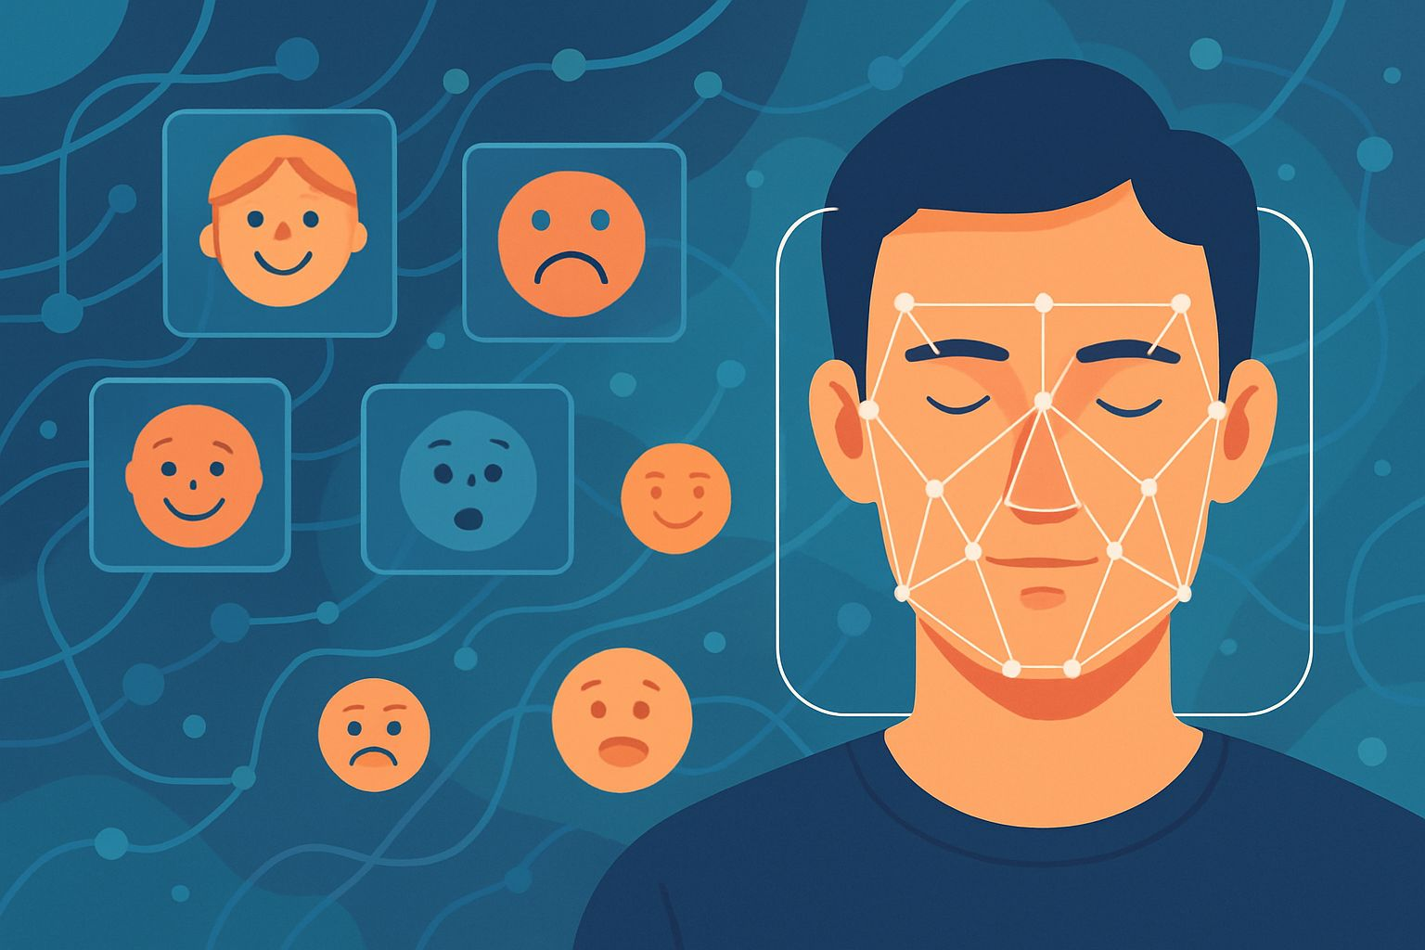
FACE DETECTION AND EMOTION RECOGNITION
APPLIED MACHINE LEARNING
- Presented by
TEAM ECHOVISION
Sayantani Saha(MDS202345)
Himanshu (MDS202328)
Sattik Biswas(MDS202343)
Suneha Sen(MDS202351)

Slide 2
INTRODUCTION
👀 Face detection with emotion recognition is a crucial task in computer vision that involves identifying human faces in real-time and understanding their emotional states. 😊😠😢
💻 In this project, we aim to build a system that performs real-time face detection and then applies emotion recognition using the DeepFace framework. Our model will classify detected faces into multiple emotional states such as happy, sad, angry, surprised, and more, providing real-time feedback through the webcam interface.

Slide 3
Why Face Detection?
1. Security and Surveillance Face detection plays a key role in identifying and tracking individuals in real-time for enhanced public safety.
2. Human-Computer Interaction (HCI) Enables smarter systems that respond to user presence, gaze, and expressions (e.g., phones unlocking via face recognition).
3. Emotion-aware Applications Forms the basis for emotion recognition in mental health monitoring, customer feedback analysis, and e-learning engagement.
4. Personalization and Marketing Used to tailor content and advertisements based on detected demographics like age, gender, and emotional state.

Slide 4
DATASET
Our dataset contains the real-world data. It consists of images of multiple individuals and real time webcam captures.

Slide 5
YOLO(You Only Look Once)
YOLO is a real-time, single-stage object detector.
It splits the image into grids and predicts:
1. Bounding boxes
2. Class probabilities for objects in each grid cell.
YOLOv12 is an enhanced version, offering improved backbone with better feature extraction.
YOLOv12 is fine-tuned here specifically for facial detection.

Slide 6
Face Detection Using YOLOv12
Load fine-tuned YOLOv12 model trained to detect faces.
Process each frame from the webcam or video input.
Run inference to detect face regions.
Draw bounding boxes on detected faces.

Slide 7
Embedding generation
🧍‍♂️Face images captured using OpenCV and YOLO-detected bounding boxes.
📸 Around 100 images per person collected for robustness.
🧠Each image passed through ResNet-50 to extract embeddings.
⚡The resulting embeddings are stored for fast lookup in real-time recognition.
🏷️ Each embedding is tagged with an identity label.

Slide 8
Face recognition: EMBEDDINGS + clustering
🔀 Weighted K-Means clusters embeddings per identity.
🎯 Each cluster is represented by a centroid.
🆕 New face embedding matched to closest centroid using cosine distance.
🚫 If similarity < threshold (0.6) → classified as unknown.
⚙️ Enables robust and scalable face recognition with unknown detection.

Slide 9
Emotion Recognition
After recognition, the face region is passed to the DeepFace framework.
DeepFace internally uses pretrained deep models for feature extraction.
It directly returns the dominant emotion: e.g., Happy, Sad, Angry, Fear, Surprise, Neutral.
Output is displayed alongside name for real-time emotion-aware recognition.

Slide 10
MODEL USED
Task | Model Used
Face Detection | YOLOv12 (custom fine-tuned),OpenCV
Embedding Generation | ResNet (pretrained)
Face Recognition | Cosine Distance Matching
Emotion Detection | DeepFace

Slide 11
WORKFLOW
Detection: YOLOv12 detects faces in frames
Embedding: ResNet encodes each face
Recognition: Compare embedding with saved ones
Emotion & Age: DeepFace classifies attributes
Output: Recognized names and age + gender+ emotions on video

Slide 12
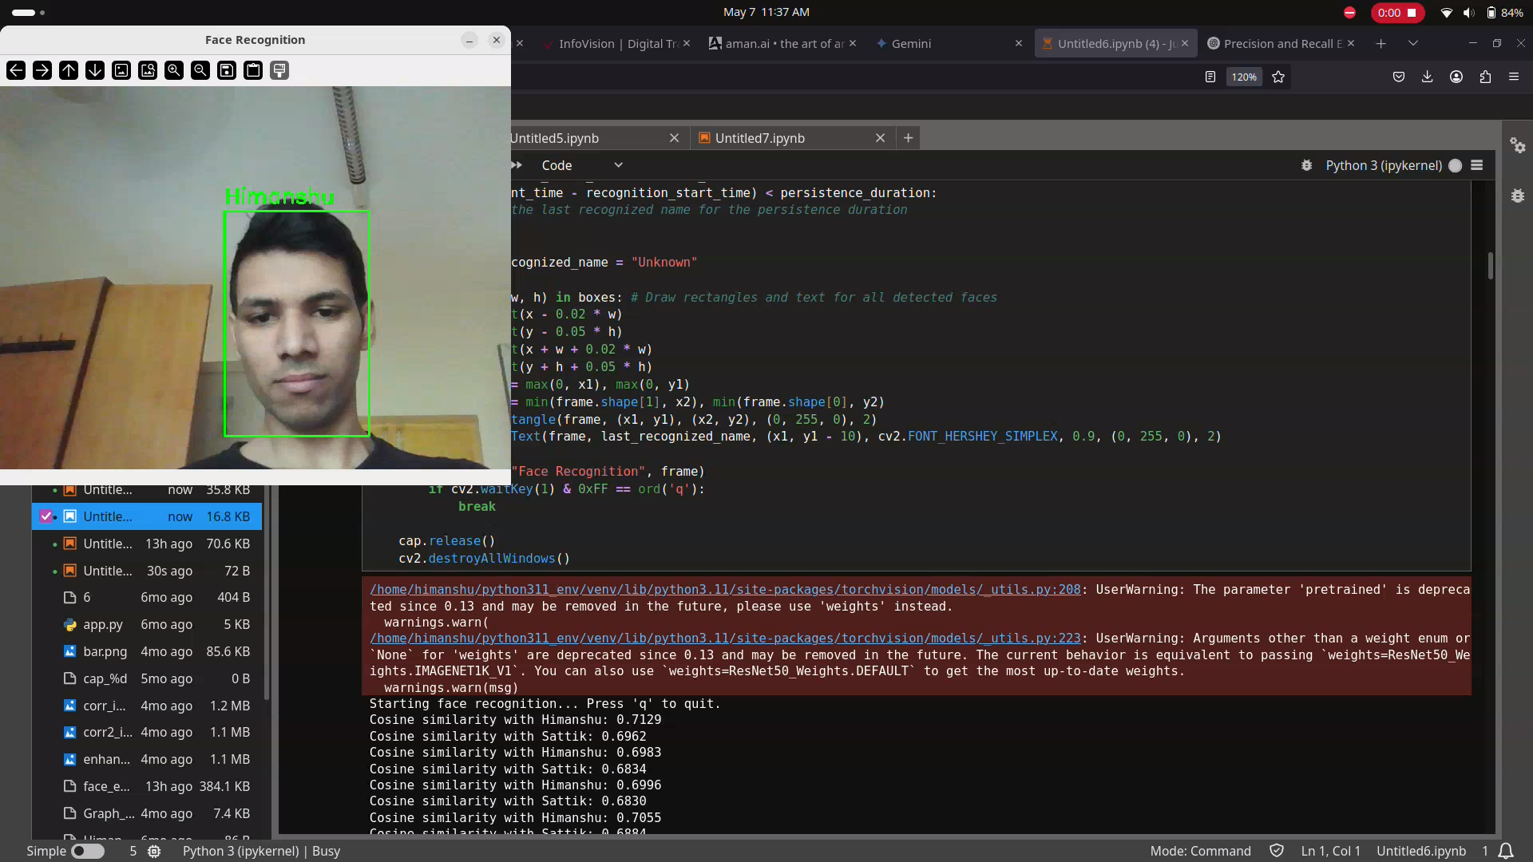
results

Slide 13
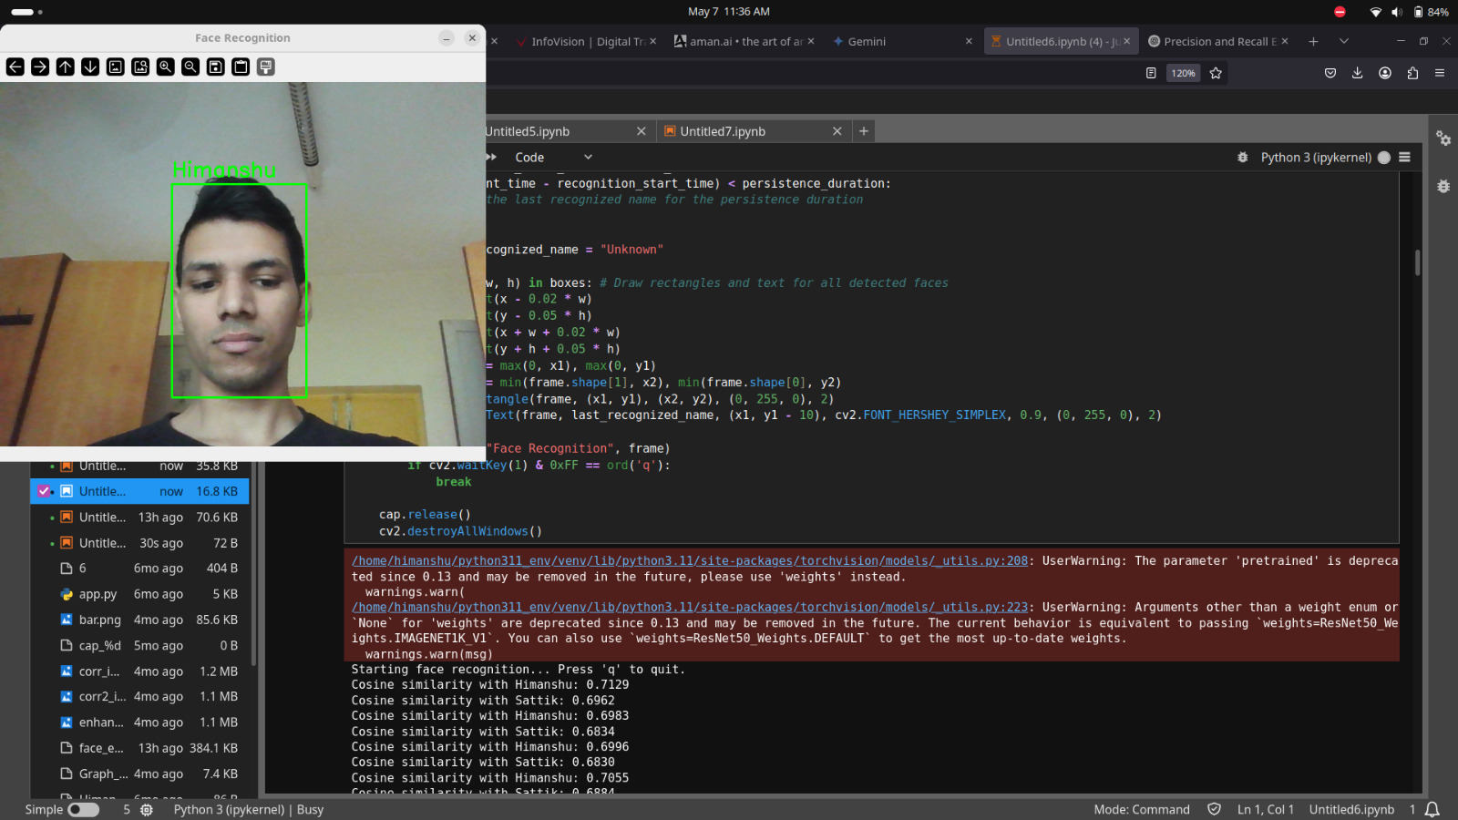
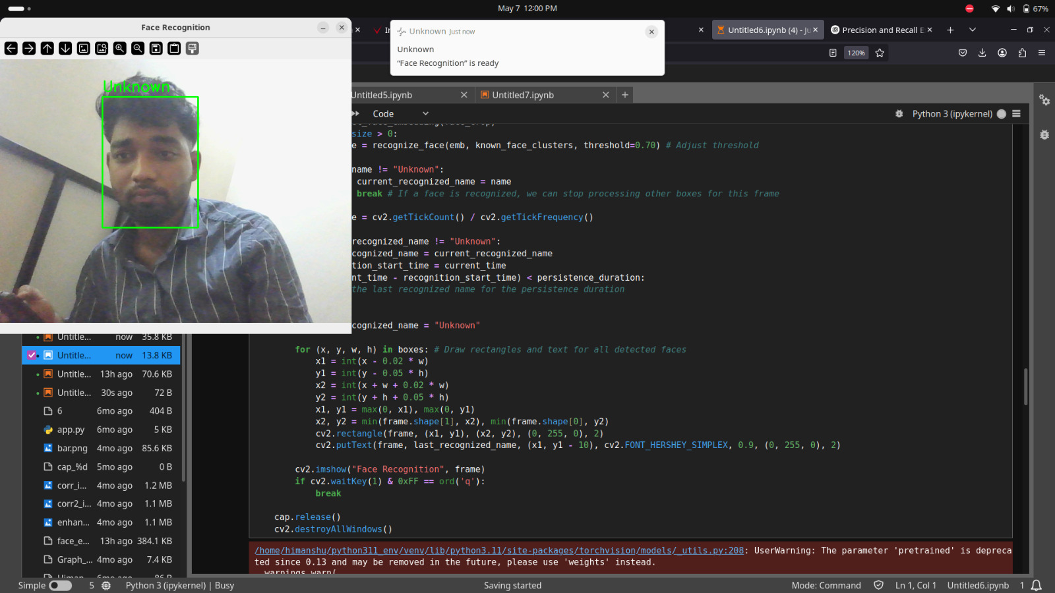
RESULTS

Slide 14
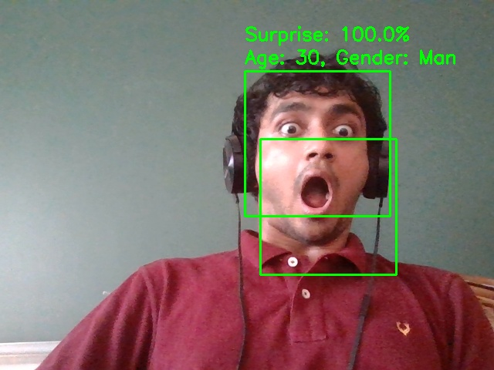
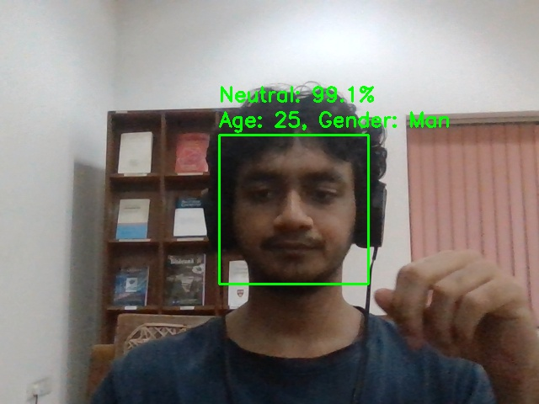
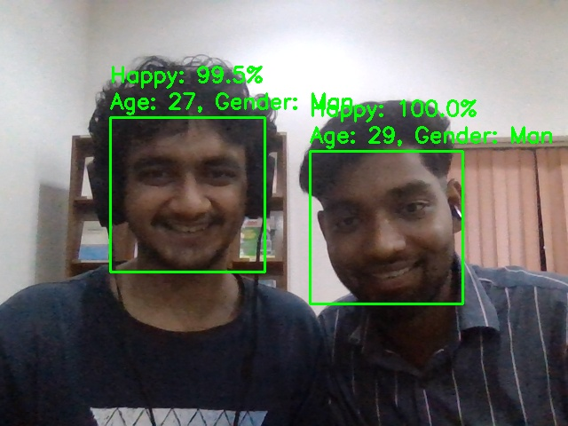
RESULTS

Slide 15
CONCLUSION
A full pipeline developed for facial analysis
Efficient due to YOLOv12’s speed and ResNet’s accuracy
Extendable to multiple applications (security, access control, etc.)
DeepFace module enhances functionality

Slide 16
FUTURE SCOPES
✅ Improve accuracy with larger, diverse training dataset
✅ Use YOLOv8 or YOLOv12 with Transformer backbones
✅ Add face spoof detection for security
✅ Deploy as a web app using Flask or Streamlit
✅ Expand to multi-camera systems for wider coverage

Slide 17
THANK YOU

